Slide 1
HP Non Stop

Slide 2
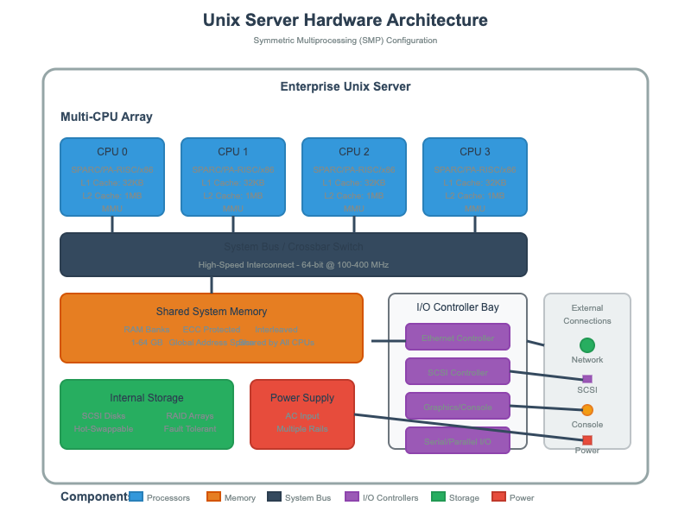

Slide 3
Unix - Demerits
Single Points of Failure
Most Unix/Linux systems rely on single CPU, memory, or motherboard
Kernel crashes bring down entire system
Hardware failures typically require downtime for replacement
Process Management
No built-in process pairs or automatic failover
Application crashes often require manual intervention
Limited automatic recovery mechanisms
Memory Protection
Shared memory architecture vulnerable to corruption
One faulty process can impact system stability
No hardware-level memory isolation between critical processes

Slide 4
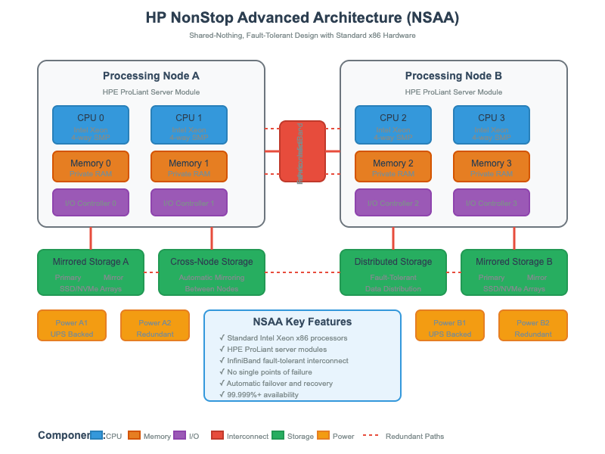

Slide 5
HP - Key Principles
No Single Point of Failure
Every component has redundancy
Automatic detection and isolation of faults
Seamless failover mechanisms
Linear Scalability
Add processors and I/O modules as needed
Performance scales nearly linearly with hardware additions
Online scaling without application changes
Shared-Nothing Architecture
Each processor operates independently
Reduces contention and bottlenecks
Enables horizontal scaling

Slide 6
Use Cases
1. Banking & Financial Services
• ATM Networks: HP NonStop powers nationwide ATM switches where every card swipe must be processed instantly, 24/7.
• Core Banking Transactions: Real-time balance updates, fraud detection, and settlement.
• Stock Exchanges: Matching buy/sell orders in milliseconds with guaranteed consistency.
2. Telecommunications
• Call Processing: Handling millions of concurrent calls, billing events, and CDR (call detail record) generation.
• Prepaid/Postpaid Charging Systems: Ensuring accurate, real-time billing for telecom operators.
• SMS/Messaging Gateways: High-throughput real-time routing and message delivery.
3. Retail & Payments
• Point-of-Sale (POS) Transactions: Retail giants use NonStop to ensure every transaction is processed instantly.
• Payment Switching (Visa, MasterCard, Rupay, etc.): Authorization, clearing, and settlement across global networks.
• Fraud Monitoring in Real-Time: Streaming transaction analysis to catch fraud before approval.

Slide 7
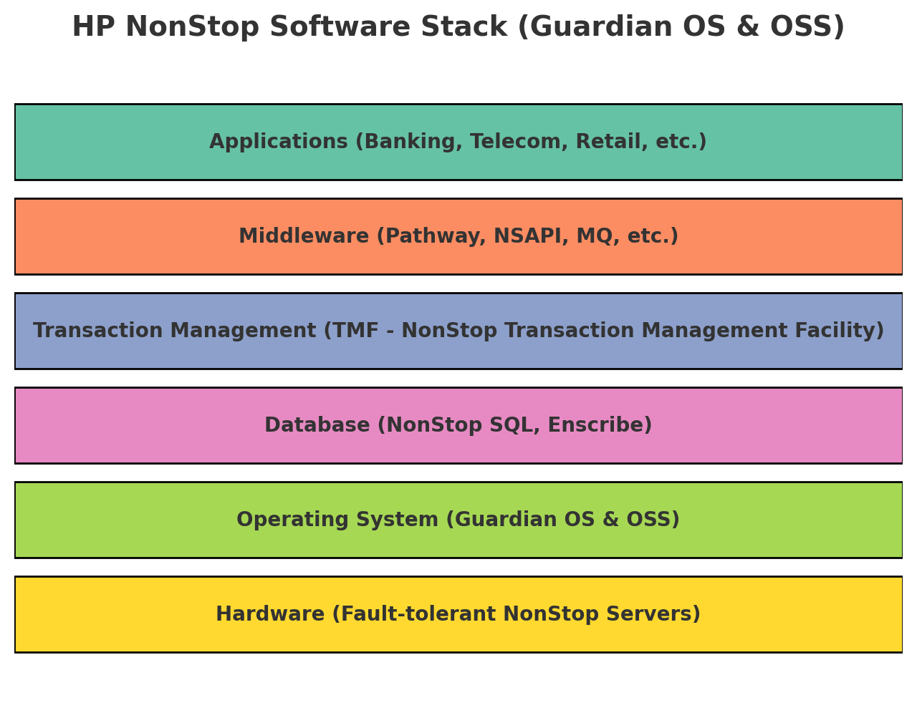

Slide 8
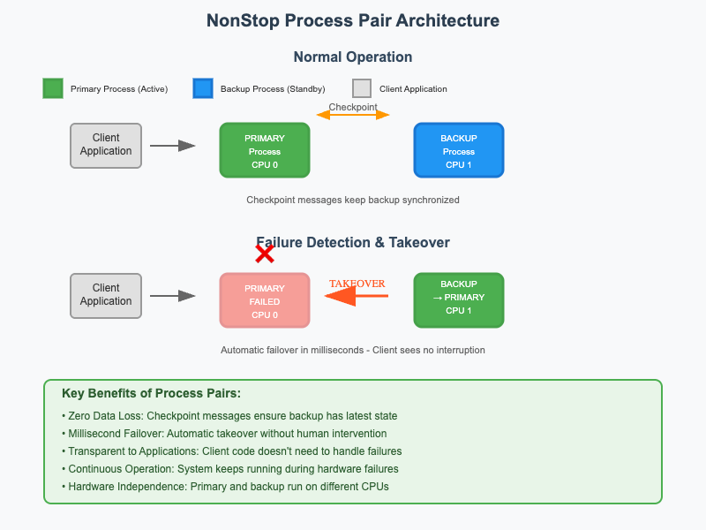
Process Pairs
Normal Operation
Primary Process: Handles all client requests and performs actual work
Backup Process: Runs on a different CPU/node, stays synchronized but remains passive
Checkpointing: Primary continuously sends state updates to backup
Failure Scenarios
When the primary process or its CPU fails:
Detection: System detects failure within milliseconds
Promotion: Backup automatically becomes the new primary
Recovery: New backup process is spawned on another CPU
Continuity: Client sees no interruption in service
What Makes This Special
Hardware Independence: Primary and backup run on different physical CPUs
State Synchronization: Backup maintains exact replica of primary's state
Automatic Management: No human intervention required for failover
Transaction Integrity: In-flight transactions are preserved during failover
This architecture ensures that even if an entire CPU board fails, the application continues running seamlessly on the backup process, achieving the NonStop system's famous "six nines" (99.9999%) availability.

Slide 9
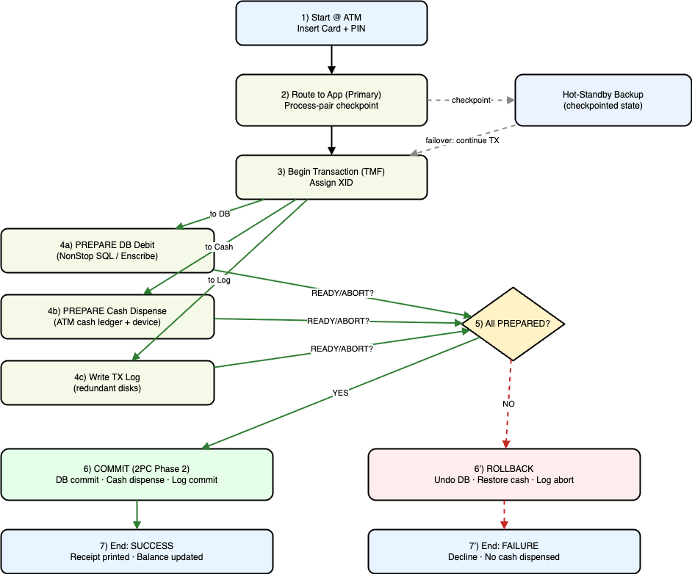
TMF - Transaction Management Facility
HP NonStop uses TMF (Transaction Management Facility) for ACID compliance:
Begin Transaction
Application starts a transaction.
TMF assigns a unique transaction ID.
Redundant Logging
All changes are first written to a transaction log stored on redundant disks.
The log is mirrored across multiple storage devices.
Two-Phase Commit (2PC)
Prepare Phase:
Each resource manager (like NonStop SQL, Enscribe, message queues) records an intent to commit.
Logs are flushed to stable storage.
Commit Phase:
Once all participants confirm “ready,” TMF issues a global commit.
If any participant cannot prepare, TMF triggers a rollback.
Rollback Mechanism
If a failure occurs mid-transaction, TMF uses the transaction log to undo changes.
Redundant process pairs ensure another CPU can continue recovery.

Slide 10
Retail Transaction Core Components
Point of Sale (POS)
Physical or virtual terminal where the customer presents a card (swipe, chip, tap, mobile wallet).
POS forms an ISO 8583 authorization request (0100) with details:
MTI (Message Type Identifier = 0100)
Primary Account Number (PAN)
Transaction amount, currency
Merchant ID, Terminal ID
Date/time, STAN (System Trace Audit Number)
Switch
The merchant’s gateway or processor switch (can be hosted on HP NonStop).
Routes transaction to the correct Acquirer Processor.
Adds routing and logging info, manages retries.
Acquirer Processor
Represents the merchant’s bank.
Authenticates the merchant, ensures the transaction format is correct.
Forwards the ISO 8583 request (still MTI 0100) to the card network/scheme (Visa, MasterCard, RuPay, Amex, etc.).
Network / Scheme
VisaNet, MasterCard Banknet, NPCI (India), etc.
Validates message structure, applies fraud/risk rules.
Routes the message to the Issuer Processor based on BIN (Bank Identification Number).
Issuer Processor
The system representing the cardholder’s bank (often HP NonStop).
Core tasks:
Check card validity (expiry, CVV, PIN if required).
Validate available balance/credit limit.
Apply fraud checks, account status, velocity limits.
Responds with ISO 8583 response (MTI 0110):
Field 39 (Response Code: “00” = Approved, others = Declined).
Bank (Core System)
The issuer’s core banking system integrated with the Issuer Processor.
Updates account balance in real-time.
Posts transaction into the ledger.

